Slide 1
High-Quality Work-Based Learning (HQWBL)
Fall Professional Development Session
November 16, 2022
Notes:
Sharon
Good afternoon and welcome to our audience today. I am excited to be participating in your professional development today for High-Quality Work-Based Learning. My name is Sharon Acuff and I am your WBL Coordinator for the Commonwealth. I would like to thank you for your attendance in our session today so we can update you on the HQWBL initiative. The HQWBL team is always here to support all of you, and don’t’ hesitate to reach out when you need assistance.

Slide 2
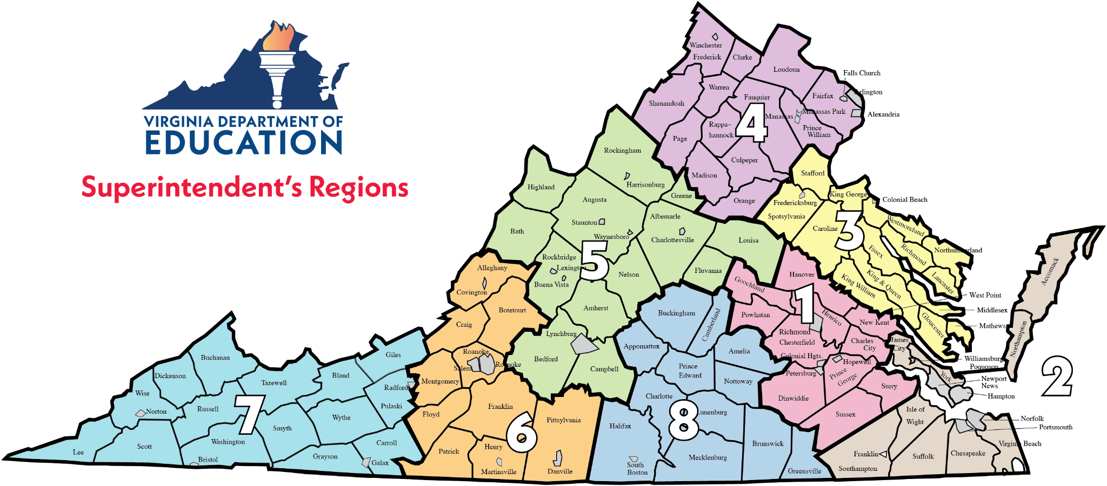
HQWBL Regional Assignments
Coordinator
Sharon Acuff
Current Regional Specialists
Erika Temple Regions 1 & 3
Nikki Finley Region 2
Susan McNamara Region 4
Amy Pultz Region 5
Kim Radford Region 6
Jan Huffman Region 7
Tammy Hurt Region 8
Region 3 Specialist later in November
100% dedication to achieving HQWBL goals in each region
Serving 131 school divisions and 23 Community Colleges in the Commonwealth
Notes:
Sharon
As shown on this map, you can see the 8 Superintendent’s regions.
I am happy that 6 of 7 the regional specialists are here today to assist with this presentation.
Dr. Tammy Hurt just joined our team on November 10 to represent Superintendent’s region 8. We will add another regional specialist on November 28 to represent Superintendent’s region 3. Both Nikki and Erika are very happy about these two individuals joining our team since they both have been covering two regions until we were able to add these two new positions. We now have 100% dedication to all 8 Superintendent’s regions for achieving High-Quality Work-Based Learning goals across the Commonwealth in 131 school divisions and 23 community colleges.

Slide 3
Session Overview
HQWBL Landscape
CTE Resource Center Website Review
VAVoyager
Overview
Guest Speakers
Notes:
Sharon
In today’s session, we will cover the following topics
The HQWBL Landscape which will include
Talent Pipeline challenges
Labor Marketing Information and why that is important and the source for obtaining that data
Information on the Top 100 Highest Paying Jobs in Virginia
How CTE Addresses Challenges
Information on the Profile of VA Graduate and Graduation Requirements
The HQWBL Connection
The three levels of HQWBL
An explanation of the HQWBL roadmap
HQWBL Competencies included in every CTE course
And, CTE Completer Follow-up HQWBL Questions
Next we will take a look at the CTE Resource Center Website and what is available there to use for implementing a HQWBL program.
After that, we will take a look at the VAVoyager platform and what this offers for providing HQWBL experiences for your students and connecting the business and industry.
And lastly, we have two guest speakers who will deliver important information as it pertains to HQWBL.
Now I would like to transition the presentation to Dr. Nikki Finley, WBL Regional specialist representing Superintendent's Region 2, who will begin the presentation on the HQWBL Landscape.

Slide 4
HQWBL
Landscape
Notes:
Nikki
At this time, we would like to find out who is joining us today. Please take this quick poll and check all those roles that apply. (Kim will activate poll).
(Kim will close the poll once)
Let’s take a look at exactly WHAT is High-Quality Work-Based Learning in Virginia.

Slide 5
Talent Pipeline Challenges
More than one-third of workers feel less confident about skills to do their jobs well (compared to pre-pandemic)
46% of employees predict their current skills “will die out” in the next few years
58% of the workforce need new skills to accomplish their jobs
https://www.instride.com/insights/talent-development-statistics/
https://www.wilsonhcg.com/blog/what-are-some-of-the-top-talent-acquisition-statistics-for-2022
Notes:
Nikki
There is evidence that the talent pathway crisis has only intensified in recent years, and most employers are struggling to hire knowledgeable talent with the skills to be successful.
In a recent study by Instride and Gartner, more than one-third of workers feel less confident about skills to do their jobs well (compared to pre-pandemic)
46% employees predict their current skills “will die out” in the next few years
58% of the workforce need new skills to accomplish their jobs
Even today, employers are finding it hard to recruit skilled talent to fill open positions.

Slide 6
Labor Market Information (LMI)
What is LMI?
Includes all quantitative or qualitative data and analysis related to employment and the workforce
Why is LMI Important?
Provides decisions for CTE programs Informs education and training offerings Facilitates career planning and preparation Identifies in-demand occupations and employment projections Narrows job search opportunities
LMI resource: CTE Trailblazers
Notes:
Nikki
Labor Market Information
The second resource that WBL Coordinators must be familiar with is Labor Market Information (LMI). Understanding LMI allows individuals to make informed plans, choices and decisions. For example:
Decisions for CTE programs
Education and training offerings
Career planning and preparation
Identify in-demand occupations
Employment projections
Job search opportunities
This is a resource that should be considered for all stakeholders.
LMI Resource: CTE Trailblazers ( We have a partnership w/ Weldon Cooper Center)
Resources on the CTE Trailblazer page:
Resources
Maps for Virginia’s Local Workforce Development Areas
Projection files in .csv format
Understanding Trailblazers Occupational Projections Data
show/click on CTE Trailblazers link & Career Cluster Analysis

Slide 7
Selected Occupations from the Top 100 Highest-Paying Jobs in Virginia
Occupational Title | Typical Entry-Level Degree/ Education | Median Salary: 2021
Chief Executives | Bachelor’s degree | $208,000 or more
Airline Pilots, Copilots, and Flight Engineers | Bachelor’s degree | $208,000 or more
Dentists, All Other Specialists | Doctoral or professional degree | $184,930
Marketing Managers | Bachelor’s degree | $162,640
Political Scientists | Master’s degree | $158,510
Financial Managers | Bachelor’s degree | $157,860
Source: Top 100 Highest-Paying Jobs in Virginia
Notes:
Nikki
Employment Projection for Selected Occupations
The following is an example of LMI data. The chart shows
Click/Show link for Top 100 jobs

Slide 8
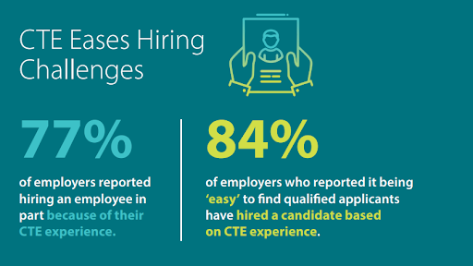
CTE Addresses Challenges
Source: Advance CTE, 2022
Notes:
Nikki
Business community - seeing talent pipeline crisis and high school students learning workplace readiness skills can help with this!
Source: Open Letter: SchoolLinks Blog
Business leaders, professional organizations, and local entrepreneurs must lead the way in opening doors for high school interns and employees. From veterinary clinics, to hospitals, to financial institutions, to technology startups, to law offices, to construction companies, business leaders should find ways to include high school students in their business development plans.

Slide 9
Profile of a Virginia Graduate
Content
Knowledge
Achieve and apply appropriate academic and technical knowledge
Align knowledge, skills, and personal interests with career opportunities
Career Planning
Workplace Skills
Community & Civic
Responsibility
Attain and demonstrate productive workplace skills, qualities, and behaviors
Community
& Civic Responsibility
Build connections and value interactions with diverse communities
Notes:
Nikki
The Virginia Department of Education (VDOE) recognizes 12 High-Quality WBL experiences. These 12 WBL experiences promote:
Career Awareness
Career Exploration, and
Career Preparation
Career Awareness
Career awareness activities prepare students for HQWBL experiences. These activities are designed to increase student awareness of personal interests and talents along with the education and training needed to pursue a career goal. Through career awareness activities, students gain an initial understanding of work, various industries, and different career pathways.
Some examples of career awareness activities are guest speakers, career days or college and career fairs, field trips and workplace tours, videos or presentations about various professions, and opportunities to conduct informational interviews. Transition visits from elementary to middle school, middle to high school, and from high school to a postsecondary program can also promote career awareness.
Career Exploration
Career exploration experiences encourage students to develop personal career interests, a better understanding of pathways to a chosen career, and the workplace readiness skills needed to make informed decisions regarding secondary and postsecondary education and training. These experiences are typically of shorter duration. Students may be assigned supplementary work connected with the activity and may be graded on their performance in a way that contributes to the final grade in a CTE class.
Career Preparation
Career preparation experiences deepen student knowledge and develop skills necessary for success in employment and postsecondary education. These experiences are recommended for students who have a clear goal of entering the workforce directly after high school or enrolling in a closely related postsecondary program. These experiences are structured primarily to give students extensive practice in applying fundamental technical and practical knowledge and skills in their chosen careers. Career preparation experiences take place over a longer timeframe and involve more responsibilities.

Slide 10
Graduation Requirements
Per Code of Virginia § 22.1-253.13:4, students are required to:
complete an Advanced Placement, honors, International Baccalaureate, or dual enrollment course; or
complete a high-quality work-based learning experience*, as defined by the Board; or
earn a career and technical education credential that has been approved by the Board.
*Excluding: Job Shadowing and Mentorship of less than 140 hours
Notes:
Amy
Thank you Nikki. Speaking of VA Graduates, the Virginia Department of Education includes HQWBL as one of the options students can use to fulfill graduation requirements.
Please note that although Job Shadowing and Mentorship of less than 140 hours are methods of HQWBL, they are do not qualify as meeting graduation requirements.

Slide 11
The HQWBL Connection
HQWBL opportunities are school-coordinated experiences that must be:
Related to students’ career goals and/or interests;
Connected to a course; and
Performed in partnership with businesses and organizations
Notes:
Amy
HQWBL is positioned to meet Talent Pipeline challenges while giving students the opportunity to gain real world exposure.
HQWBL opportunities are school coordinated experiences that go beyond the classroom.
In order for the experience to be considered HQWBL, it MUST meet 3 criteria
be aligned with the students career goals and/or interests
it must be connected with a course in which the student is enrolled. This course will provide technical and Workplace readiness skills to the students
And there must be a partnership with a business or community organization.

Slide 12
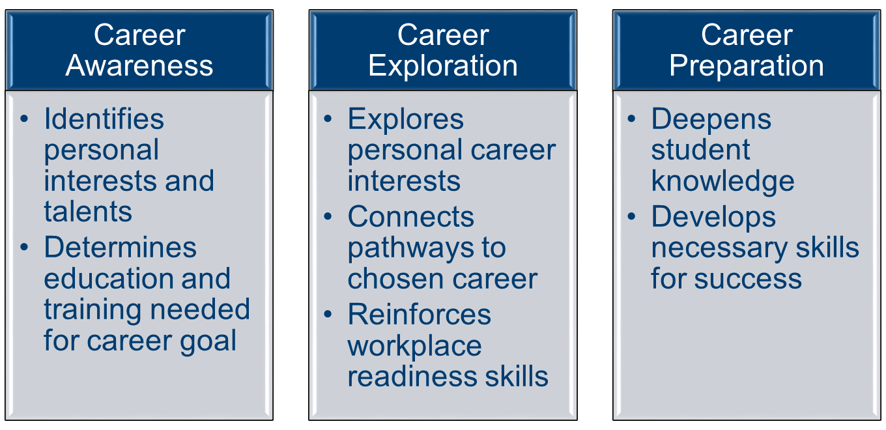
The 12 HQWBL Experiences Promote:
Notes:
Amy
The HQWBL experiences recognized by the Virginia Department of Education (VDOE) promote:
Career Awareness
Career Exploration, and
Career Preparation
Career awareness activities prepare students for HQWBL experiences. These activities are designed to increase student awareness of personal interests and talents along with the education and training needed to pursue a career goal. Through career awareness activities, students gain an initial understanding of work, various industries, and different career pathways. Some examples of career awareness activities are guest speakers, career days or college and career fairs, field trips and workplace tours, videos or presentations about various professions, and opportunities to conduct informational interviews. Transition visits from elementary to middle school, middle to high school, and from high school to a postsecondary program can also promote career awareness.
Career exploration experiences encourage students to develop personal career interests, a better understanding of pathways to a chosen career, and the workplace readiness skills needed to make informed decisions regarding secondary and postsecondary education and training. These experiences are typically of shorter duration. Students may be assigned supplementary work connected with the activity and may be graded on their performance in a way that contributes to the final grade in a class.
Career preparation experiences deepen student knowledge and develop skills necessary for success in employment and postsecondary education. These experiences are recommended for students who have a clear goal of entering the workforce directly after high school or enrolling in a closely related postsecondary program. These experiences are structured primarily to give students extensive practice in applying fundamental technical and practical knowledge and skills in their chosen careers. Career preparation experiences take place over a longer timeframe and involve more responsibilities.

Slide 13
12 HQWBL Experiences
Grades 6-12
Grades 9-12
HS Credit Earned | Green
Service Learning
Externship
Job Shadowing
Mentorship
140 hours or more
.5 credit
School-Based Enterprise
Entrepreneurship
280 hours or more
1 credit
Internship
280 hours or more
1 credit
Cooperative Education
280 hours or more
1 credit
Registered Apprenticeship
Supervised Agricultural Experience
(Immersion)
280 hours or more
1 credit
Clinical Experience
Youth Registered
Apprenticeship
280 hours or more
1 credit
Notes:
Amy
This roadmap also identifies the grade levels for when students can participate in the experiences. The implementation of this continuum is to prepare students for the higher intense experiences once on a secondary and post-secondary level.
The experiences for students begin with less intense opportunities such as job shadowing, to more intensive opportunities such as cooperative education and youth registered apprenticeship.
The experiences in green allow students to earn high school credit - when associated with a high school class.

Slide 14
HQWBL Competencies
Identify the types of HQWBL opportunities*
Reflect on lessons learned during the HQWBL experience
Explore career opportunities related to the HQWBL experience*
Participate in a HQWBL experience, when appropriate
* Required competencies
Notes:
Amy
HQWBL competencies are a part of ALL CTE Courses and are listed here.
Identify HQWBL opportunities and exploring career opportunities related to the HQWBL experience are required for EVERY CTE course.

Slide 15
CTE Completer Follow-up
HQWBL Questions
How satisfied are you with the Work-Based Learning experience(s) you had?
How closely are your current professional and educational goals related to the career you explored during your Work-Based Learning program?
Overall, how much impact did your Work-Based Learning experience have on your college and career decision as you transitioned to your current employment, military service, or continued education?
Notes:
Amy
HQWBL experiences are also a part of federal reporting guidelines through the CTE Completer Follow-up survey. This survey is given to student CTE completers who have met the requirements for a career and technical concentration and is conducted 9-12 months after graduation.
I will now pass the presentation over to Kim Radford, Regional Work-Based Learning Specialist assigned to Region 6 to discuss HQWBL Resources.

Slide 16
HQWBL CTE Resource Center Website and Resources
Notes:
Kim

Slide 17
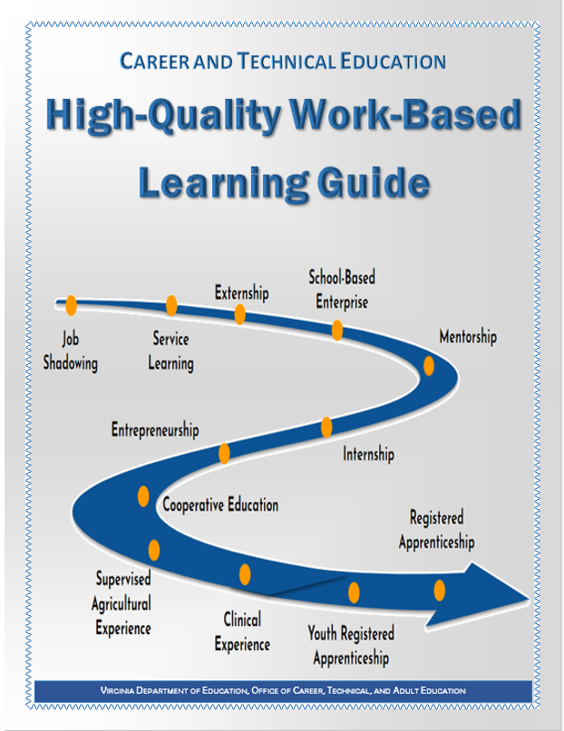
HQWBL Guide
The #1 HQWBL resource!
Board approved for implementation on August 4, 2022
Now effective and posted on the VDOE website
Notes:
Kim ( make sure to stress that the audience may click on the graphic for a copy of the guide)
CHAT LINK:
Direct Link to HQWBL Guide: https://view.officeapps.live.com/op/view.aspx?src=https%3A%2F%2Fwww.doe.virginia.gov%2Finstruction%2Fcareer_technical%2Fwork-based_learning%2Fdocuments%2Fwbl-guide.docx&wdOrigin=BROWSELINK
Jan
Especially for newer WBL Coordinators, the HQWBL Guide can be a great resource.
On June 15, 2022, the Board approved the updated HQWBL Guide.
Following a public comment period, the Guide became effective on August 4th and is now posted on the VDOE website and CTE Resource center and the VAVoyager HQWBL Resource Announcements.
The first update to the new guide is the new cover. It features the HQWBL Roadmap showing the 12 HQWBL experiences and the intensity progression.
Work-Based Learning (WBL) Guide
The first and number one resource that all WBL Coordinators must be familiar with is the WBL Guide.
It provides definitions, roles, sample forms and responsibilities for all stakeholders in order to implement High-Quality WBL experiences.
Examples of information located in the WBL Guide:
Guidelines for implementing the twelve (12) WBL methods practiced in Virginia
Resources pertaining to federal and state labor regulations
WBL Coordinator/Teacher Qualifications
Recommendations for promoting WBL programs
The importance of WBL documents
The active link on this slide will take you directly to the WBL Guide.

Slide 18
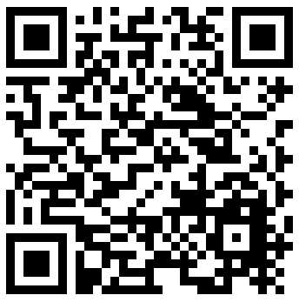
Additional HQWBL Resources
HQWBL Time Log & Wage Calculator
Experience Works - sessions and exhibitor videos
HQWBL At-A-Glance (one-pagers)
Downloadable HQWBL and VAVoyager forms
Notes:
Most of our resources are currently housed on the CTE Resource Center HQWBL Web page.
Here is a QR code to this website. The URL for the web page is also at the bottom of this slide.
So, What resources can be found here?
There are many which include:
The most recent version of the 2022 HQ Work-Based Learning Guide just posted on August 4th - Susan will speak a little bit more about this in a moment
The updated HQWBL Time Log & Wage Calculator that CTE teachers can use to record wages and hours for student experiences
Experience Works - we’ll provide a QR code for this in a moment
The high-quality work-based learning at-a-glance documents - great marketing tools for students, parents and business partners
We also now have a VDOE HQWBL YouTube Channel. You can search for VDOE HQWBL YouTube and easily find it.
GO SUBSCRIBE!
Here you will see videos of the Student Trailblazers featured at EW last month and the new Learn & Earn: Explore, Connect and Succeed
This video is a great resource to introduce HQWBL to students, parents, and even school staff. Use the links that have been placed in the chat to quickly access these resources.
"Access to ALL downloadable forms is coming soon - including VAVoyager forms and HQWBL Universal Forms". They will have access through the Canvas link.

Slide 19
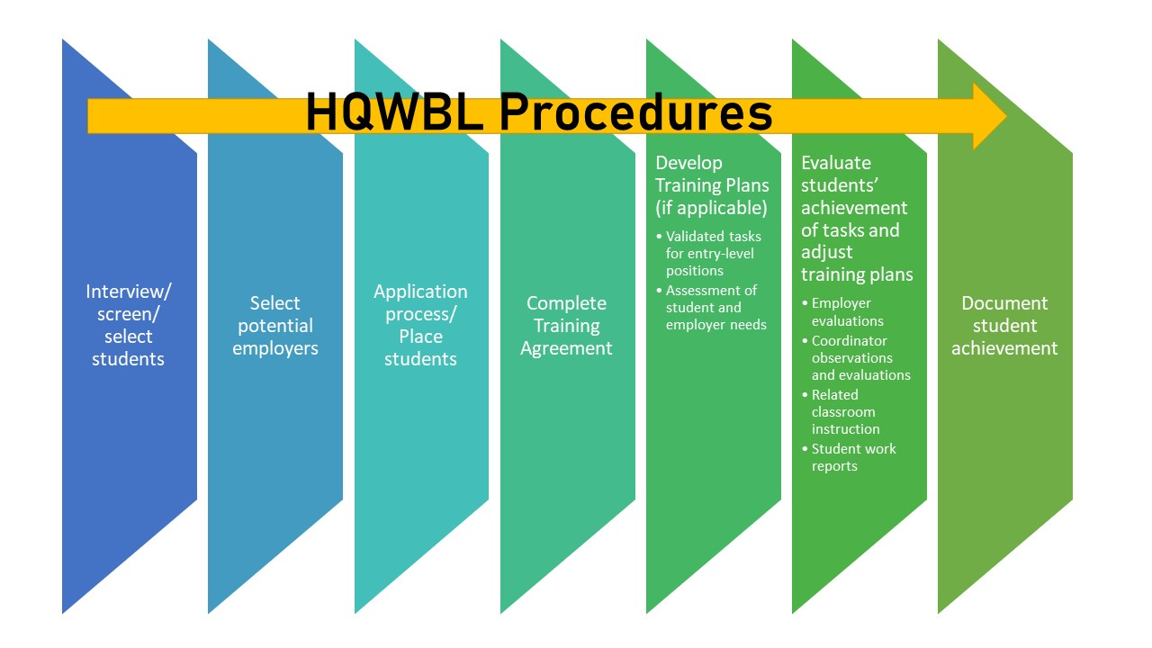
Notes:
Kim
Additionally, a new Canvas Resource Site for HQWBL has been developed and is live. Not only is it a repository for all HQWBL resources, there is a dedicated portion of the Canvas Resource site for VAVoyager. We will focus your attention to the VAVoyager content.

Slide 20
VAVoyager Overview
Notes:
Susan
Thank you, Kim. Good afternoon everyone. Thank you for joining us today.
Now we will provide a brief overview of VAVoyager.

Slide 21
Launched Fall 2022
Tagline created by: Ibaadullah Hassan, Academies of Loudoun
Logo created by: Tanmeo Jones and Tamia Fenner, Richmond Technical Center
For ALL High Schools across the Commonwealth
Notes:
Susan
The VAVoyager PLATFORM LAUNCHED THIS FALL, 2022
This is a Virtual HQWBL network for students and it has also been branded by students.
Tagline created by: Ibaadullah Hassan, Academies of Loudoun
Logo created by: Tanmeo Jones and Tamia Fenner, Richmond Technical Center

Slide 22
Notes:
Susan
Benefits of VAVoyager include:
First, this Virtual Work Based Learning Network is FREE to all school divisions.
It is a repository for HQWBL Opportunities from across the Commonwealth
Reporting on meaningful post-secondary credentials for identified HQWBL opportunities and the capability of sharing those reports with the VA Community College System.
Connecting student performances on assessments to HQWBL experiences
Creating searchable employer job board postings for HQWBL experiences
Users will be able to generate reports related to
HQWBL educator, partner or student activities
Paid HQWBL experiences
Disaggregated information by school divisions/ schools/ students
And finally, the number of non-duplicated employers participating and total cumulative wages earned
The wage piece is specifically important as it will indicate the potential economic effects on the local economy related to HQWBL programs
The network opportunities provide both face to face and virtual HQWBL opportunities
The network will also help to increase HQWBL opportunities in rural areas
Lastly, it will help to expand business partnerships in the 17 career clusters

Slide 23
Stakeholders
Employers
HQWBL Coordinators
Students
Increase community exposure
Expand student talent pool
Improves efficiency by reducing steps to connect students to opportunities
Easily track student WBL information
Increased ownership and autonomy to explore WBL opportunities
Centralized location to manage WBL experience and paperwork
Notes:
Susan
Who can benefit from VAVoyager? All HQWBL Stakeholders - Employers, WBL Coordinators, & Students.
With VAVoyager:
The employer stakeholders will have Increased community exposure for the employers
The student talent pool from which employers can select will be Expanded
WBL Coordinator can experience Improved efficiency by reducing steps to connect students to opportunities
And they can Easily track student HQWBL information
Students will have Increased ownership and autonomy to explore HQWBL opportunities
And a Centralized location to manage HQWBL experience and paperwork
Now, I will transition the presentation to Dr. Jan Huffman who will provide a demonstration of the platform.

Slide 24
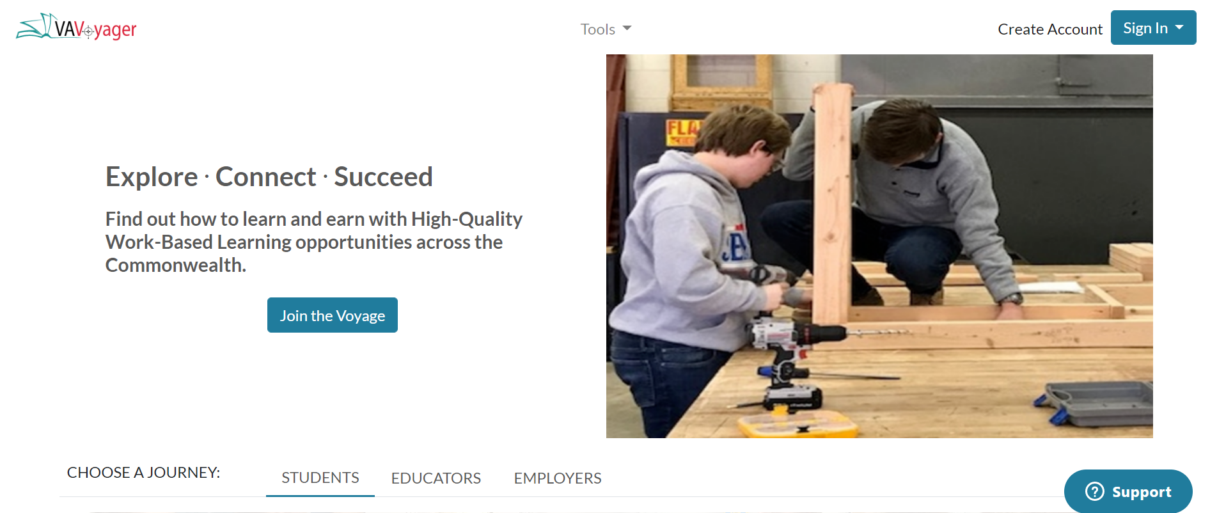
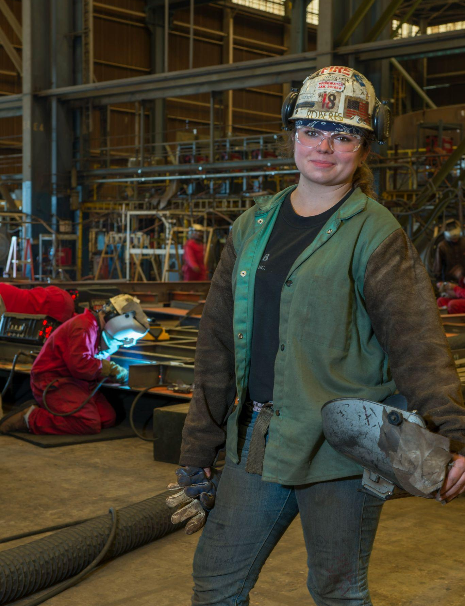
VAVoyager Landing Page
Notes:
Jan

Slide 25
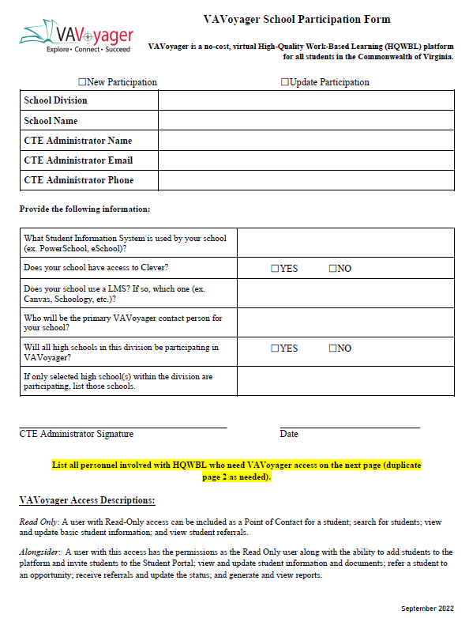
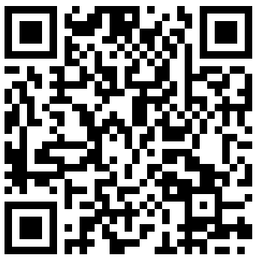
Connect with your Regional Work-Based Learning Specialist
Provide an access list
Determine a point of contact
Easy As 1-2-3
Notes:
Jan
To get started with VAVoyager, we need a School Participation form from your CTE administrator.
This form will need to be submitted annually to update the access information on the platform. These may be new WBL points-of-contact, email addresses, or associated schools. We have provided you with a QR code if you want a copy of this form, we have provided you with a QR code.
We recommend that a person be appointed as a Point of Contact to connect with Regional Work-Based Learning specialist for all things VAVoyager related. It will be a CTE Administrator’s decision on which staff will have VAVoyager access. And this may be more than one person.

Slide 26
Guest Speakers
Notes:
Tammy

Slide 27
HQWBL Coding
Joseph Ryder
Data Collection, Reporting & Accountability Specialist
Office of Career, Technical, and Adult Education
joseph.ryder@doe.virginia.gov

Slide 28
HQWBL Reporting
Data is collected through the Master Schedule Collection in the Fall and End of Year
HQWBL experiences are enhancements of instruction and must be attached to the F record of a student participating in a CTE course or an academic course
F records in the Master Schedule Collection include a section ID that connects the record to the C record which contains the course data
It is important that F records be individualized to the students, using blanket settings by section ID in your Student Information system will lead to inaccurate reporting

Slide 29
C Record (Course Record)
C Record:
Provides information about the course, also known as a course record
Generates the section ID which is used to categorize students and teachers associated with the course
Includes location, division and SCED designations for each course

Slide 30
F Record (Student Record)
Record Type | Section ID | Local Provider ID | State Testing ID | Local Student ID | Final Grade | Remote Course Indicator | Dual Enrollment Flag | Work-based Learning Code (All Courses)
F | Horticulture1A | JSmith2021 | 2451291287 | 19524 | A |  |  | 1
F | Horticulure1A | JSmith2021 | 3695412698 | 22347 | B |  |  | 1
A record for each student participating in the section
Should be individualized for the student, meaning that each students F record should be generated specifically for that student rather than F records being generated for the entire section
This is particularly vital with HQWBL as students may not all participate in the HQWBL experience associated with the course. For example, Student 1 may participate in Culinary Arts II and leave for part of their day to participate in Co-Op where they work at a local restaurant. Student 2 however may participate in the Culinary Arts II course, but elects not to participate in Co-Op. In the F record for Student 1, a HQWBL code of 1 would be added for the Culinary Arts section, Student 2 would not receive a HQWBL code as they did not participate in the enhanced experience

Slide 31
YRA and RA
Crystal Thrower
Registered Apprenticeship Consultant
Virginia Department of Labor and Industry
crystal.thrower@doli.virginia.gov
Notes:
Tammy (Introduce Crystal Thrower)

Slide 32
VIRGINIA DEPARTMENT OF LABOR AND INDUSTRY DIVISION OF REGISTERED APPRENTICESHIP
Registered Apprenticeship
YOUTH PROGRAMS

Slide 33
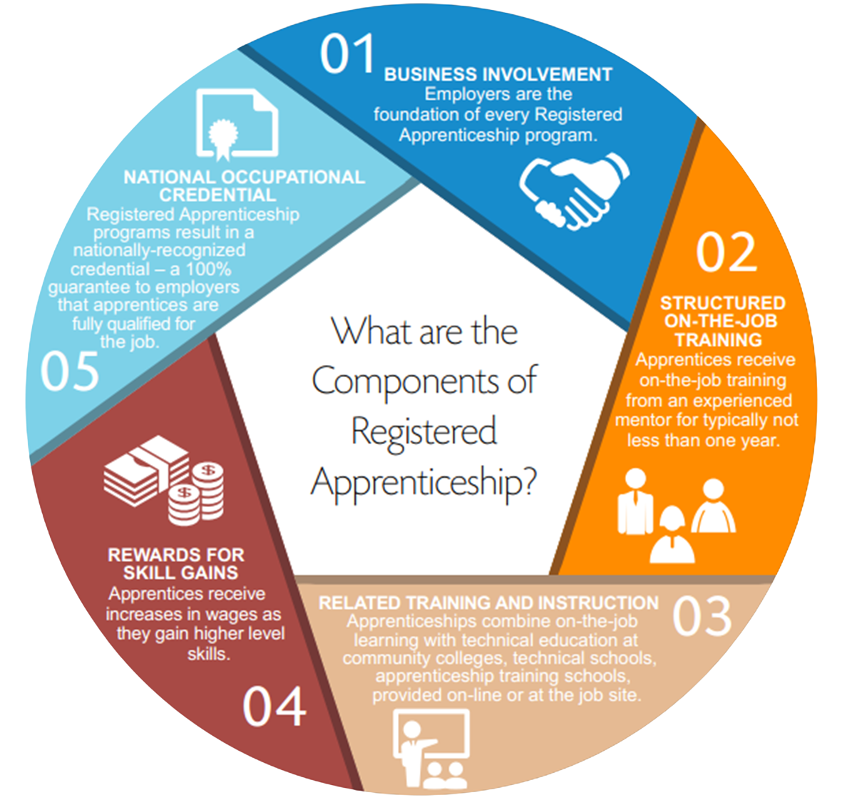

Slide 34
The Adult Program
Registered Apprenticeship (RA)
A Program for anyone 16+ who has separated from High School.
May work full or part-time
Participate in Occupation Specific Related Technical Instruction
Must satisfy a minimum of 2000 OJT Hours and 144 RTI Hours

Slide 35
Youth Registered Apprenticeship (YRA)
A Program for High School Students 16+ enrolled in a Career and Technical Education (CTE) program.
Related Technical Instruction comes from the CTE curriculum.
YRA may be part-time or full-time at various times of the year.
Registered with The Division of Registered Apprenticeship
Upon Graduation receives a Certificate of Participation
Work hours earned may be credited to the Adult program
This participant can receive 1 credit hour towards graduation if they complete for 280 hours of OJT

Slide 36
Registered Apprenticeship Work-Based Learning
(RA-WBL)
A Program for High School Students ages 16+
Student may be part-time or full-time at various times of the year.
Related Technical Instruction to be decided by the Employer / Registered Sponsor
Registered with The Division of Registered Apprenticeship
Work hours earned may be credited to the Adult program

Slide 37
LET'S RECAP
CAREER & TECHNICAL EDUCATION PROGRAMS ARE OFFERED AT THE HIGH SCHOOL LEVEL
AT AGE 16, STUDENTS CAN WORK FOR COMPANIES WHO OFFER ON THE JOB TRAINING RELATED TO THEIR CLASS
THE COMPANY REGISTERS THE STUDENTS AS YOUTH APPRENTICES
UPON GRADUATION STUDENTS BEGINS WORKING FOR FULL-TIME AND THEY MOVE TO THE ADULT APPRENTICESHIP PROGRAM
THE STUDENT TAKES THE REMAINING RELATED TECHNICAL INSTRUCTION COURSES

Slide 38
TIMELY FACTS
Begin a RA program 16 years old
Employee/Earn as you learn
Earn Nationally Recognized Credential
Pathway to career
Hands-on training and to gain experience
Targeted support
Career advancement
Ability to earn higher wages
Competitive advantage

Slide 39
Crystal Thrower, MBA MPA
Registered Apprenticeship High School Work-Based Learning Specialist
Tel: (703)392-0900 Ext. 102
Email: crystal.thrower@doli.virginia.gov
Kathleen E. Eddington
Assistant Director, Division of Registered Apprenticeship
Phone: (804) 786-2382
Email: kathleen.eddington@doli.virginia.gov

Slide 40
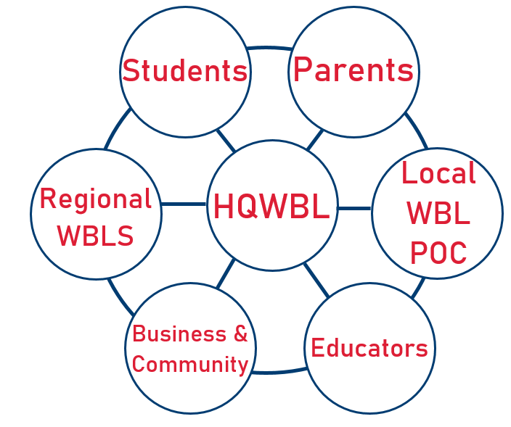
We’re All In This Together
Notes:
Sharon
As you can see by this graphic, we are all in this together. It takes students, parents, educators, and business and community along with local WBL points of contacts, regional work-based specialists to make all of this successful across the Commonwealth. All of us must work together to offer varied HQWBL experiences for students and help business and industry to build a talent pipeline.

Slide 41
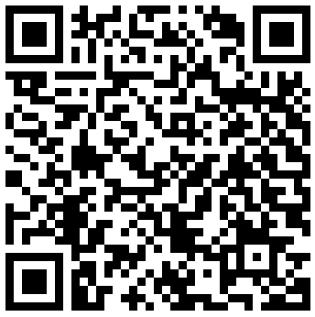
Regional HQWBL Specialist Contact Information
Amy Pultz
Work-Based Learning Specialist - Region 5
amy.pultz@doe.virginia.gov
Kim Radford
Work-Based Learning Specialist - Region 6
kimberly.radford@doe.virginia.gov
Dr. Jan Huffman
Work-Based Learning Specialist - Region 7
jan.huffman@doe.virginia.gov
Dr. Tamantha Hurt
Work-Based Learning Specialist - Region 8
tamantha.hurt@doe.virginia.gov
Sharon Acuff
Work-Based Learning Coordinator
sharon.acuff@doe.virginia.gov
Erika Temple
Work-Based Learning Specialist - Regions 1 & 3 erika.temple@doe.virginia.gov
Dr. Nikki Finley
Work-Based Learning Specialist - Region 2 nikki.finley@doe.virginia.gov
Susan McNamara
Work-Based Learning Specialist - Region 4
susan.mcnamara@doe.virginia.gov
Notes:
Sharon
Here is our team’s contact information. We appreciate the opportunity to speak with you today and look forward to collaborating with you in the future. We are always available to help and support you with your HQWBL needs.
If you have not had an opportunity to complete the survey on your preference of the format for the Experience Works conference in June 2023, please take a moment to complete the short survey. The link is being placed in the chat.
(Kim will place link in the chat)
Experience Works 2023 Format Survey: https://virginiadoe.gov1.qualtrics.com/jfe/form/SV_798cLT4OQUbElPo
The recording of this presentation and the powerpoint will be posted to the CTE Resource website. Please be aware there are active links throughout our presentation that are recommended for you to access for future reference.
Thank you so much for your attendance today. We wish you the best as you implement HQWBL in your school division. Have a great rest of the afternoon and evening.

